Slide 1

Discover the Power of KIEhealth
A section 125 wellness program.

Slide 2

What is KIE Health?
KIEhealth is a preventative medical plan qualified under Section 125 that is administered through a robust wellness platform that includes interactive applications with quantifiable analytics.
No initial setup cost to the employer.
Employees receive an automatic raise with plan.
An overall estimate of potential savings will be provided on each census.
Menu of qualified providers and enhanced medical benefits are built directly within the plan.
Data analytics utilizing revolutionary technology to manage population health.
Average employer savings ranges from $400-$600 per employee per year (overall savings is based on number enrolled).
A HIPPA-compliant voluntary supplemental medical plan, compliant with IRS codes 125, 213 and 105, and backed by a Legal Protection Plan.

Slide 3
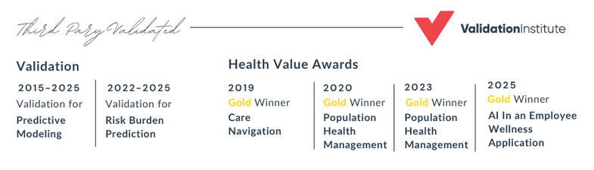
Validated to
Make a Difference
Using validated and award-winning AI and Care Navigation, Group Advisors can:​
  Predict future medical issues​
  Predict cost of these issues​
  Engage employees to prevent disease​
  Reward employees for engaging​
  Improve your bottom line​
At no out-of-pocket cost to you or your employees.

Slide 4

A Dual Approach
Well-Being Services
Section 125 Cafeteria Plan
It includes both a benefit payment for participating in monthly activities and access to a comprehensive suite of health tools. These include advanced health tracking software, 24/7 telemedicine with a $0 co-pay, online learning modules, health screenings, and more.
The Section 125 cafeteria plan allows you to cover the cost of participating in the wellness program on a pre-tax basis through salary reduction.​

Slide 5


What KIE Health Offers:
Health Benefits
The program offers health coaching, telemedicine, behavioral health, and more!
Increased Education & Engagement
Increase employee engagement with preventative healthcare and educate them about health risks before they become serious.
Proactively Reach Employees With the Highest Medical Claims
Research shows that it’s mostly your healthy population that participates in programs. Our program incentivizes all parties to engage—even the unhealthiest.
Employees Boost Their Income
Employees on the program will see an increase in take-home pay with participation and no out-of-pocket cost.
Employers Savings
Employers, on average, will save $600/employee per year in payroll tax savings with no out-of-pocket cost.

Slide 6
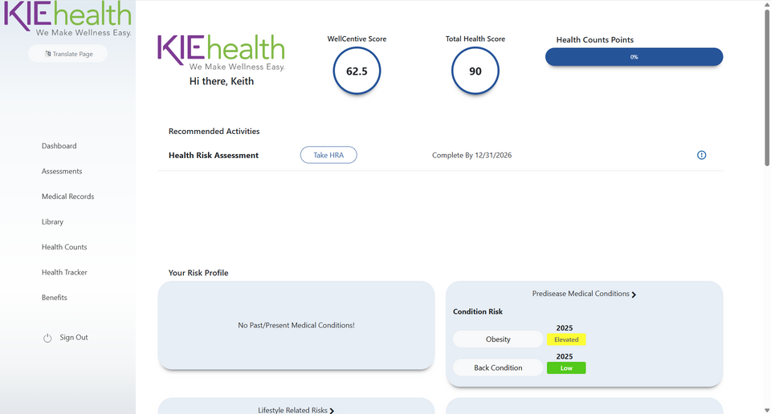
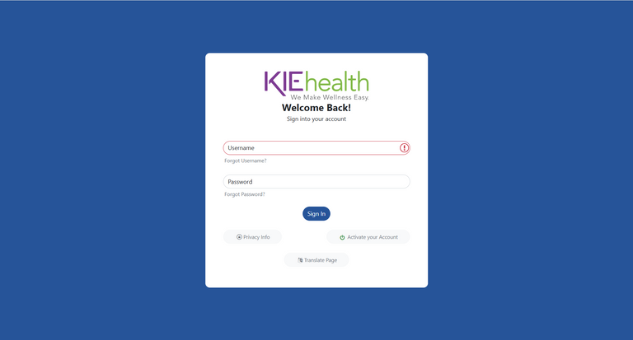
Employee Benefits Included in the Plan
Personal Health Dashboard™
Wholeistic™ Coaching
Telemedicine

Slide 7
Personal Health Dashboard™
The PHD can be translated into over 60 languages and has many functions.
Complete Health Risk Assessment (HRA).
Complete behavior modification modules.
Watch over 250 modification modules.
Connect your wearable directly to the fitness tracker.
Use the Benefits tab to learn more about additional free benefits.

Slide 8
Paycheck Example
Using $31,200.00 per year sample information.
 | Without KIE Health | With KIE Health
Monthly Gross Pay | $2,600.00 | $2,600.00
Major Medical Premium | $0.00 | $0.00
Additional Pre-tax Deductions | $0.00 | $0.00
Wellness Plan Premium | $0.00 | -$1,200.00
Taxable Income | $2,600.00 | $1,400.00
Federal Withholding | $142.13 | $15.00
Social Security | $161.20 | $86.80
Medicare | $37.70 | $20.30
State Withholding | $86.69 | $33.66
Post-tax Income (Paycheck from Employer) | $2,172.28 | $1,244.24
Wellness Reward | $0.00 | $1,000.00
Total Amount to Bank Account | $2,172.28 | $2,244.24
Dollars available for employees to use at their discretion | $0.00 | $71.96
$71.96
Per-Month Increase
$75.07
Per-Month Increase
$863.52
Per-Year Increase
$912.84
Per-Year Increase
KIE Health cannot guarantee the same favorable tax outcome in all situations as federal and state tax laws are continuously changing.

Slide 9
Premium $1000 X 7.65% = $76.50 - $35.00 Employer Fee=$41.50
Annual Savings $498
Premium $1200 X 7.65% = $91.80 - $35.00 Employer Fee=$56.80
Annual Savings $681.60
Premium $1400 X 7.65% = $107.10 - $35.00 Employer Fee=$72.10
Annual Savings $865.20
EMPLOYER SAVINGS & COMPARISONS

Slide 10
Implementation Timeline
Tasks
Week 1
Week 2
Week 3
Week 4
Week 5
Week 6
Week 7
Week 8
KIE Health
Group
Task
Initial Payroll Analysis
Proposal
Contracting: BAA, Employer Agreement, New Client Form
Detailed Payroll Analysis
Banking ACH Form
Cafeteria Agreement
Payroll Setup, Codes, Dry Run
Member Communications, Planning & Strategy
Go Live (First Payroll)
Invoicing

Slide 11

How it Works
Step One
Step Two
Step Three
Step Four
Begin by activating your account and watching the intro video on your effective date.
Each month, complete a health activity. We recommend that you start by completing the online HRA.
You will receive a monthly newsletter via email, text, or mail to stay compliant with the program.
Manage your tasks and beneﬁts on the PHD, including an individual risk proﬁle, a risk resolution center, and health reminders.

Slide 12

Bottom Line:
Better Employee Health
Better Employee Benefits
Enhanced Employee Pay
Increased Profits
All while REDUCING COSTS

Slide 13

Thank you for empowering a healthier tomorrow.

